Slide 1


Python Scripting
Improvement Suggestions
Nick Draper
11/08/2011

Slide 2
Outline
Requirements
Improvement suggestions
Prioritisation

Slide 3
User Requirements
Return workspaces from Algorithms
  ws=Load(“bob”,”c:\file.nxs”)
Allow other data objects
  UB Matrices
Functions on workspaces
  ws2 = ws.rebin(“0,100,20000”)
Easily extract data for use in NumPy
  Allow data back into mantid after manipulation
Slicing of workspaces
  ws=ws[12000:13000]
Allowing editing of workspaces

Slide 4
User Requirements
iPython as the Mantidplot Interpreter
Improve intellisense for external libraries
Support plotting from outside Mantidplot
Support algorithm dialogs outside of Mantidplot
Support Instrument view outside of Mantidplot

Slide 5
Internal Requirements
Improve child algorithm operation
Allow for temporary workspaces
Python access to MD workspaces

Slide 6
Return Workspaces from Algorithms
Syntax
  ws=Load(”c:\file.nxs”)
  returns the output workspace “ws”.
  (ws1,ws2) = Create2Workspaces(“bob”)
  two outputs returned as a tuple, “ws1” and “ws2”.
  ei=GetEI(“bob”,0,2,2,3,false)
  return value is not a workspace

Slide 7
Return Workspaces from Algorithms
Issues
  Rebin(BigWs,”10,1,200”)
  Return value not captured!
  Print a warning, create the workspace and then delete it on exit. This seems wasteful
  Not Backwardly compatible.
    Options:
      Allow old API to be used in scripts
        low_level_api()
        from mantidsimple import *
      Provide a script to translate existing scripts

Slide 8
Allow other data objects
At the moment you can only store workspaces
Expand that to store other objects
  E.g. UB Matrices
Provide a simple class to inherit from to allow new results objects to be defined
Allow the direct passing of any result object into an algorithm (that expects it), also Numpy arrays.

Slide 9
Functions on workspaces
Syntax
  ws=ws.rebin(“10,100,10000”)
  ws=ws.convertUnits(“wavelength”)
  ws=ws.transpose()
Issue
  Should we do inplace changes or return the result?
    Inplace: ws.crop(10,20) – more intuitive
    Return: ws=ws.crop(10,20) – more powerful
Implementation
  A subset of algorithms will be added to workspaces that can support them.
  Each algorithm will define which workspaces it can be attached to.

Slide 10
Easily extract data for use in NumPy
Syntax
  Reference View
    No copying – immediate changes to data on write.
    View=Ws.dataX() – return read only ref list of all spectra
    View2=view[12000:13000] – copy respective references to new view
    Array = view[1] – a read/write numpy array of element 1 of the view
  Extracting 2D NumPy arrays
    w.ExtractX() – copies data to a 2D numpy array
    w.ExtractX(range(900,1000),[3,4,5]) – copy selected region into 2D numpy array
    Use CreateWorkspace to recreate a mantid workspace from the extracted numpy arrays

Slide 11
Allowing editing of workspaces
Allow direct access to edit any values in a workspace
Limit loss of history recording
  Record a “Workspace directly edited” history record
Syntax
  array = ws1.dataX(1)
  Extracts a writable numpy array of the X data from WorkspaceIndex 1
  array[2] = 3.4
  Alters the data in index position 2 to 3.4

Slide 12
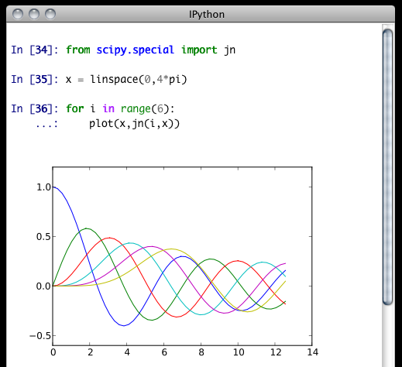
iPython as the Mantidplot Interpreter
We can integrate iPython
Issues
  Requires Python 2.6
    Therefore cannot support RHEL 5
    Move ISIS to RHEL 6?

Slide 13
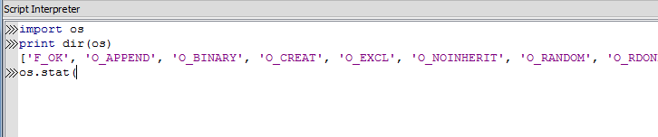

Improve intellisense for external libraries
Intellisense does not work beyond Mantid objects
Could use the python introspection to give help outside of Mantid objects

Slide 14
Support plotting from outside Mantidplot
Provide consistent plotting commands in/out of Mantidplot
Syntax
  plotSpectrum(“ws”,0,errorBars=true)
  plotBin
  ws.plotGraph2D()
Issue
  Not providing support for formatting graphs initially

Slide 15
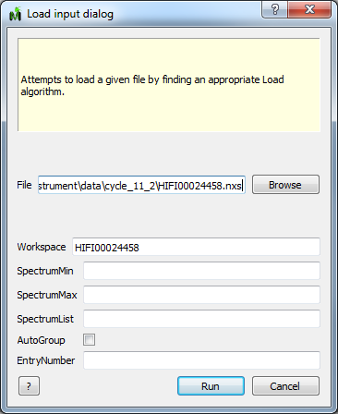
Support algorithm dialogs outside of Mantidplot
The algorithms dialogs in could be used from external python scripts to request specific user values.
Syntax
  LoadDialog()
  RebinDialog(InputWorkspace=”bob”)

Slide 16
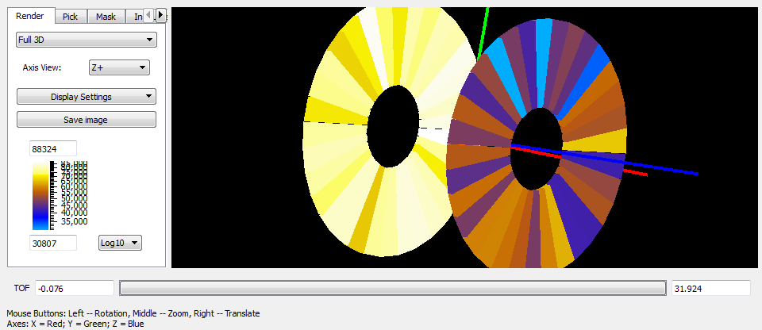
Support Instrument view outside of Mantidplot
The Instrument view could be used in python scripts that are not run within Mantidplot.
Syntax
  instrument_view = getInstrumentView('wsBob')
  instrument_view.showWindow()
Issues
  This is a lot of
  work

Slide 17

Prioritisation
Discussion

Slide 18
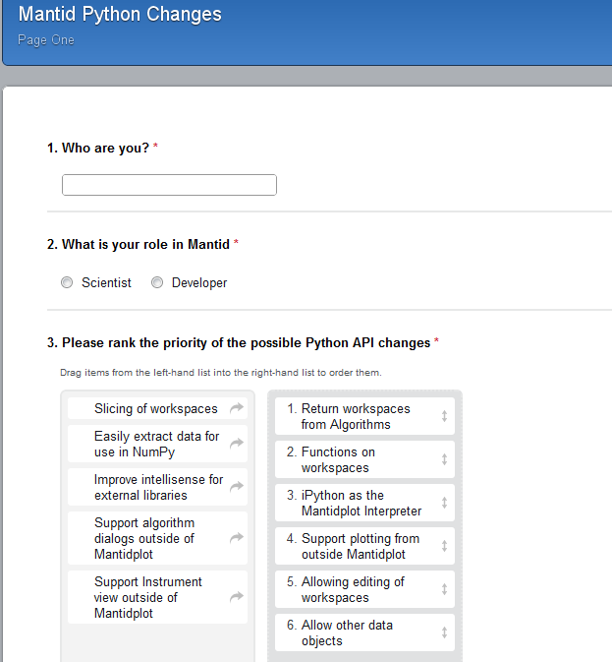
Prioritisation
Survey
  Just one page
http://www.surveygizmo.com/s3/611397/Mantid-Python-Changes

Slide 19
Links
Design Document
  http://svn.mantidproject.org/mantid/trunk/Documents/Design/MantidPythonScripting.doc
Survey
  http://www.surveygizmo.com/s3/611397/Mantid-Python-Changes

